Slide 1


WEEK 10
SPRINT 4
PL6
REQ

Slide 2


about us.

Slide 3
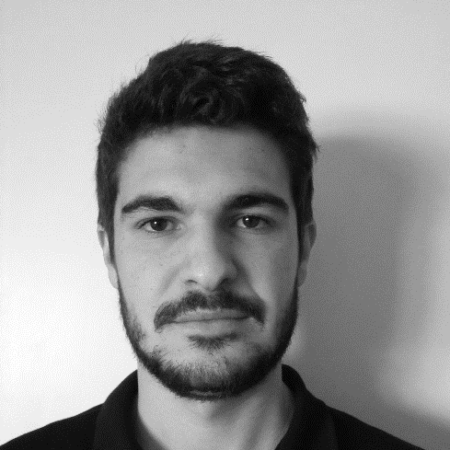
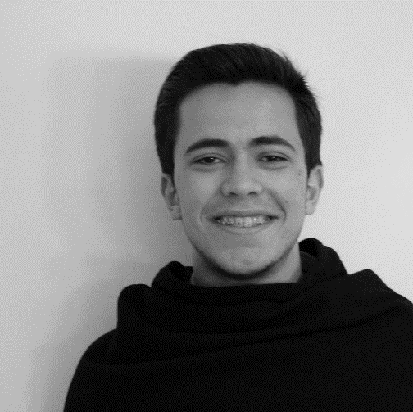
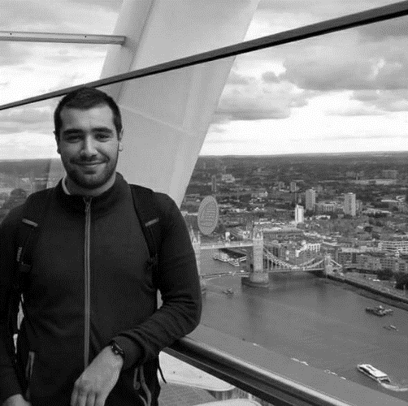

req.
Emanuel
Marco
Paulo
Nuno

Slide 4
tasks.
 | TASK #1 | TASK #2 | TASK #3 | TASK #4 | TASK #5
TASK | Finish Mockups Sprint 3 | Finish requirements document – Sprint 3 | Weekly presentation | Finish Quality Manual – Sprint 3 | Inspection meeting
OWNER | Nuno | Emanuel, Paulo | Marco | Marco | Team
GOAL EFFORT | 2 H | 3 H 00 | 1 H | 1 H 00 | 1 H 30
EFFECTIVE EFFORT | 2 H 30 | 4 H 00 | 0 H 40 | 1 H 30 | 2 H 00
STATUS | COMPLETED | COMPLETED | COMPLETED | COMPLETED | COMPLETED

Slide 5
planned tasks.
 | TASK #1 | TASK #2 | TASK #3 | TASK #4
TASK | Update Mockups – Sprint 4 | Update Requirements document - Sprint 4 | Revision – Quality Manual – Sprint 4 | Meeting with cliente
OWNER | Nuno | Emanuel, Marco Paulo | Emanuel, Marco, Paulo | Emanuel
GOAL EFFORT | 4 H 00 | 6 H 00 | 2 H 30 | Emanuel, Paulo
STATUS | NEW | NEW | NEW | NEW

Slide 6
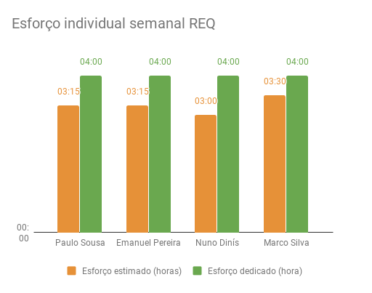
Effort.

